Slide 1
A Lexicon for Profane and Obscene Text Identification in Bengali
CSE431: Natural Language Processing
Team 3
Shaoli Farzana 20101553
Rajvir Ahmed Shuvo 20141003
Ehsanur Rahman Rhythm 22241163

Slide 2
Introduction
Motivation
Popularity of e-commerce and social media
Bangla, a low resource language
Monitor online Bangla content
Identification of obscenity
Contribution
Bengali obscene lexicon consisting of 200 swear words
The lexicon is based on a corpus-based semi-automatic approach using obscene corpus and word embedding and POS tagging.
Demonstrate the efficiency of the lexicon using Bengali social media content

Slide 3
Related Work
2019-Hateful speech detection in public facebook pages for the bengali language - Using supervised ML classifiers.
2019- A deep learning approach to detect abusive bengali text- Many classifiers
2020- Classification benchmarks for under-resourced bengali language based on multichannel convolutional-lstm network.- BengFastText , predicting hate speech
2021-Abusive content detection in transliterated bengali-english social media corpus-Introduction to an annotated Bengali corpus.

Slide 4
Corpora
Development Corpus
construct the lexicon
subset of a Bengali corpus deposited by (Abu, 2020)
Consisting 3902 obscene comments
Evaluation Corpus
Evaluating the lexicon
subset of the dataset deposited by Sazzed (2020a)
Consisting 2643 non-obscene reviews and 664 obscene reviews

Slide 5
Creation of Obscene Lexicon
Text Processing Tools
Lexicon Creation Framework
Developed Lexicon
Now we need to actually create the Bengali lexicons.

Slide 6
Text Processing Tools
Part Of Speech Tagger
POS tagger is a text analysis tool that assigns a POS tag (e.g. noun, verb, adjective etc.) to each word of a piece of text data.
Word Embedding
A word embedding creates similar representations of words that are related in some ways.
Two main approaches
Count-based
Context-based

Slide 7
Lexicon Creation Framework
Selection of Seed Words
Based on the word-occurrence count, the top 100 words are selected.
Expansion of Lexicon
In the first step, we identify words that are the most similar to the seed words.
In the second step, the duplicate words are removed automatically.
Manual Validation
Finally non-obscene words are excluded manually
Leveraging lexical resources can assist in identifying the presence of profanity in Bengali social media.

Slide 8
Developed Lexicon
The English translation is provided to give an idea of the type/characteristics of the lexicon.
Due to language-specific differences, the exact English translation may not be available for some of the words present in the developed obscene lexicon

Slide 9
Obscenity Detection in Textual Content
Identifying profane reviews
Two Supervised ML classifiers
Logistic Regression (LR)
Logistic regression (LR) is a predictive analysis model that assigns observations into a discrete set of classes.
Support Vector Machine (SVM)
SVMs are discriminative classifiers with separating hyperplanes. SVM categorizes unseen observations with an optimal hyperplane from labeled training data.
An Optimizer
Stochastic Gradient Descendent (SGD)
SGD is an optimization technique and does not correspond to a specific family of machine learning models. It is only a way to train a model.
We compare the performance of the developed lexicon with several supervised classifiers in the evaluation corpus.

Slide 10
Obscenity Detection in Textual Content
To evaluate the performance of various ML classifiers and the SGD optimizer, we employ them in both original class-imbalanced and modified class balanced settings.
Initial class-balancing uses SMOTE (Synthetic Minority Oversampling Technique) sampling.
The original class-imbalanced setting uses all 664 obscene and 2643 non-obscene negative comments. The modified class balanced setting uses all 664 obscene comments, but for the non-obscene class, we randomly select 664 from 2643.
We use the TF-IDF score based on unigrams and bigrams as a feature vector. To compare how well different ML classifiers work, 10-fold cross-validation is used.

Slide 11
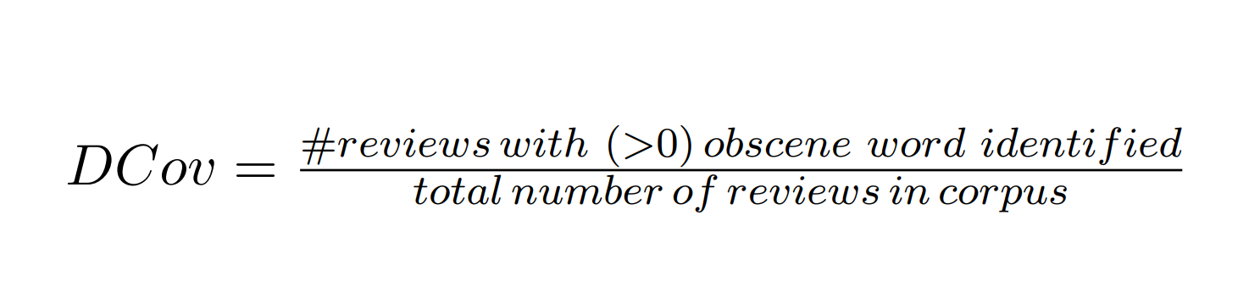
Obscenity Detection in Textual Content
Document-level coverage (DCov) shows the lexicon's efficacy.
The following equation is utilized to calculate DCov for a corpus-corresponding lexicon:
Finally, the developed lexicon is manually validated, so it consists mainly of obscene or profane words and has a negligible chance of mislabeling a non-obscene comment as obscene (false positive).
DCov illustrates the recall score for obscene class detection using ML classifiers.
Evaluation Metric

Slide 12
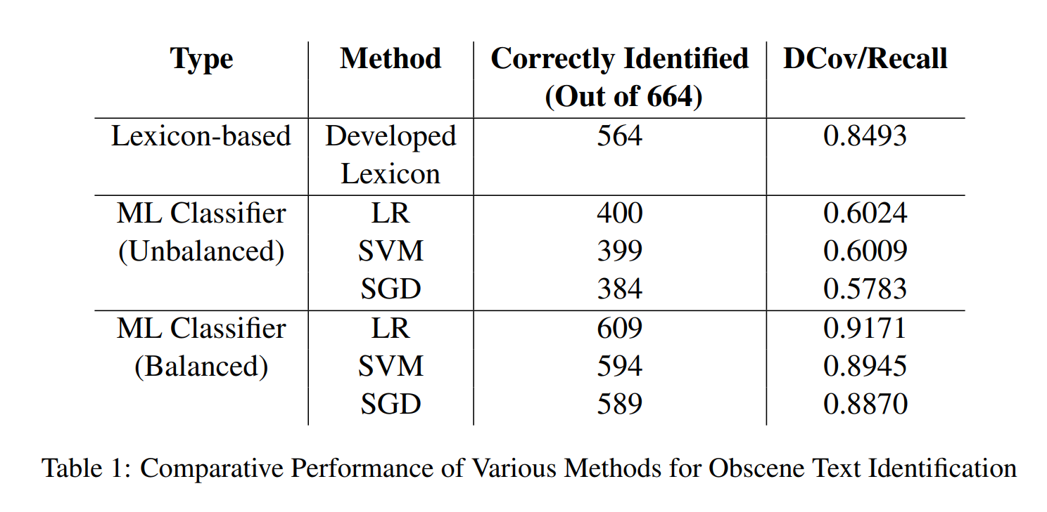
Obscenity Detection in Textual Content
Comparison Results

Slide 13
ML classifiers and the SGD optimizer outperform the developed lexicon in class-balanced datasets.
In low-resource languages like Bengali, labeled data are scarce, so the developed lexicon can be used to identify obscenity.
If there isn't a large enough pool of offensive comments, the ML classifiers may struggle. The constructed vocabulary has the potential to be extremely useful in this setting.
When annotated data are unavailable, the obscene lexicon can be used to identify obscenity in Bengali social media content.
In future, Larger and multi-domain development corpora will be used to expand the lexicon.

